Slide 1
Attacking Java for fun and profit a quick view on useful Fuzzing approaches
Vladimir Dashchenko, Kaspersky ICS CERT
Sergey Temnikov, Independent Security Researcher

Slide 2
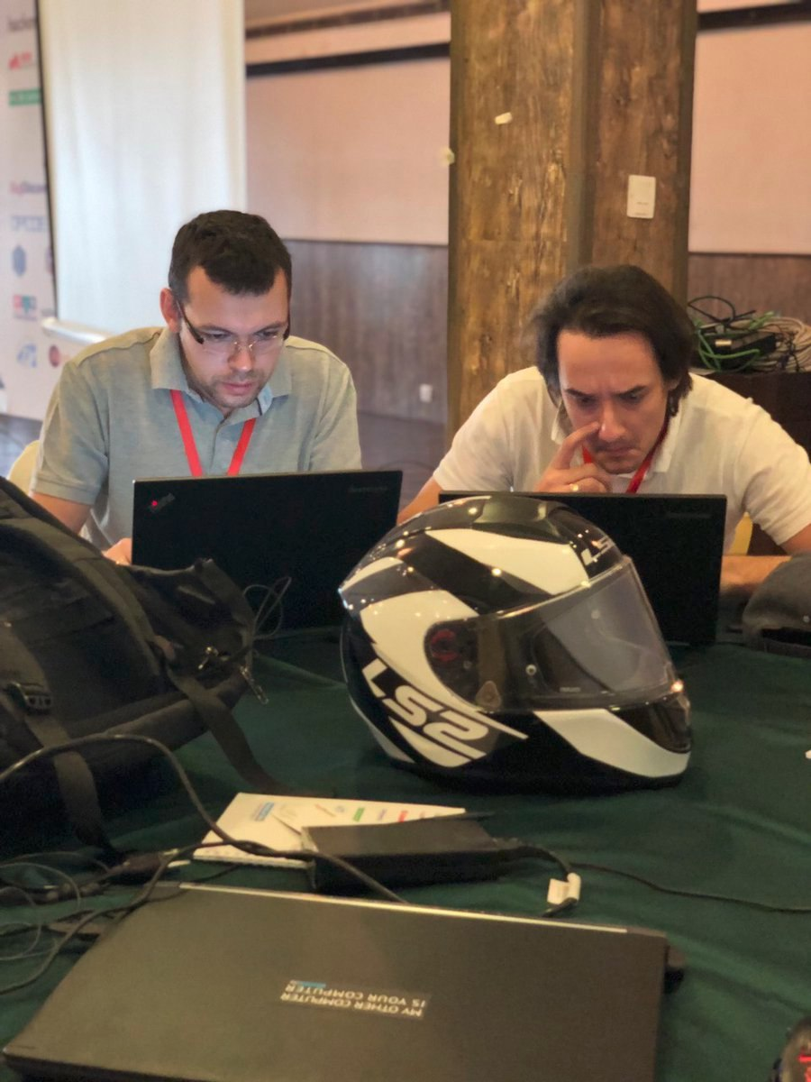
Hello world
Sergey and Vladimir
Total vuln research: 25 years+
Hundreds of vulnerabilities
Incident responses
0day exploitation research
Cars, smart things, ICS, IIoT, OS etc…
Innovations in fuzzing
Custom offensive security trainings (fuzzing, vulnerability research, supply chain security)

Slide 3
Fuzzing 101
WHO KNOWS WHAT IS FUZZING?
WHO USES FUZZING IN DAY-TO-DAY WORK ACTIVITIES?
WHO HAS FUZZING CLUSTERS?
DOES YOUR BUSINESS/MANAGEMENT UNDERSTAND THAT FUZZING IS IMPORTANT?

Slide 4
Fuzzing 101
What is fuzzing?
Fuzzing - as an effective offense strategy to discover flaws in the software of the opponents. It showed tremendous potential in the automation of vulnerability detection
The goal of fuzzing is to stress the application and cause unexpected behavior, resource leaks, or crashes
The process involves throwing invalid, unexpected, or random data as inputs at a computer. Fuzzers repeat this process and monitor the environment until they detect a vulnerability.

Slide 5
Fuzzing 101
What is fuzzing?
Fuzz testing was developed at the University of Wisconsin Madison in 1989 by Professor Barton Miller and students. Their (continued) work can be found at http://www.cs.wisc.edu/~bart/fuzz/ ; it’s mainly oriented towards command-line and UI fuzzing, and shows that modern operating systems are vulnerable to even simple fuzzing.
(c) owasp.org
Fuzzing is a part of SDLC and important security practice

Slide 6
Fuzzing 101
What can be fuzzed?
Pretty much everything:
Protocols
Fonts
Files
Any kind of data parsers
Types of fuzzing:
Black box – when you don’t have source code
White box – when you have source code
Gray box – when you do not have source code, but have some documentation/specification

Slide 7
Fuzzing 101
FUZZING VS UNIT TESTS (OTHER QA PRACTICIES)

Slide 8
Fuzzing 101
Data inputs
Generated data
Mutated data
Each subsequent iteration’s data is created independently of any previous input. This approach is based on a model of the input format.
Changes of the existing data are done according to certain patterns

Slide 9
Fuzzing 101
FUZZING IS SIMPLE!
Identify target
Identify inputs
Generate mutated data
Execute mutated data
Monitor behavior
Logs logs logs!

Slide 10
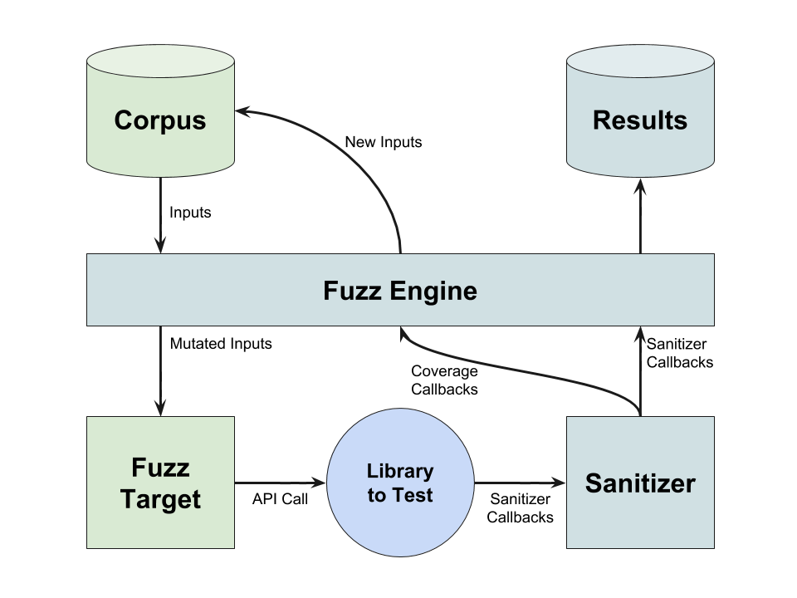
Fuzzing 101

Slide 11
Fuzzing 101
WHERE ARE MY 0DAYS???
This is you when you run your first fuzzer

Slide 12
Fuzzing 101
Come here all my sweety 0days!
This is you when you know how and what to fuzz

Slide 13
JAVA FUZZING!
Disclaimer: this is only an educational information. We ask you to follow responsible disclosure policies. Be good, don’t be bad.
Our final goal – RCE/LPE. The rest also counts, but.. ☺

Slide 16
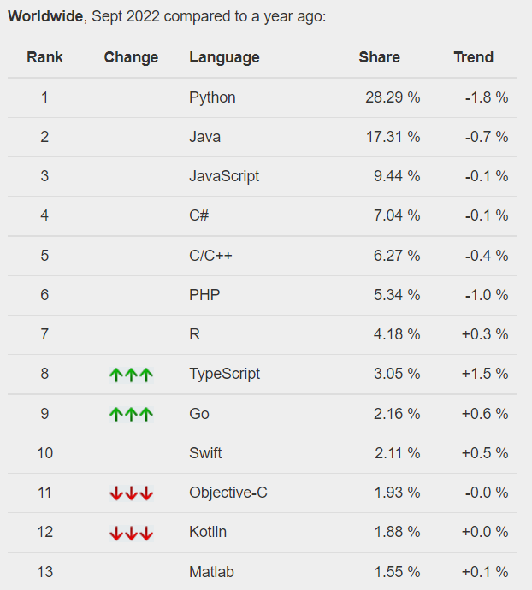
Is java popular?
Oh yes! And even more than 3 bln devices now

Slide 17
Java vs other fuzzing
Binary app: you expect an app to crash (segmentation fault). Sometimes (only) it helps to catch RCE/LPE
Java: when you have BOF/Integer overflow this is not an error. This is an ‘Exception by design’. This does not bring you RCE/PLE, no logical flaws/issues

Slide 18
Why java fuzzing
What is the point of Java fuzzing?
There can be a classical binary vulnerability while you work/fuzz Java app:
There’s a small chance of JVM (logical) vulnerability
JVM uses native libraries. For example: crc32/zip/true font
Relatively often you can find a class sun.misc.Unsafe. This is basically a direct usage of malloc/free/memcpy . Another words, this is a direct access or usage of memory through the pointer that is not being checked or verified

Slide 19
Why java fuzzing
What is the point of Java fuzzing?
Network applications – it is important to get DoS scenarios! For us it is important to find an ‘infinite loop’ condition. In this case we can load microprocessor and halt the whole server application

Slide 20
Why java fuzzing
What is the point of Java fuzzing?
Logical vulnerabilities – we need them. And find ‘exceptions’. For example: SQL Query exceptions. This will help us to find non-trivial SQL Injection.
"You have an error in your SQL syntax; check the manual that corresponds to your MySQL server version for the right syntax to use near ‘‘VALUE’’."

Slide 21
Some important things to remember
Some important things to remember about fuzz targets:
The fuzzing engine will execute the fuzz target many times with different inputs in the same process.
It must tolerate any kind of input (empty, huge, malformed, etc).
It must not exit() on any input.
It may use threads but ideally all threads should be joined at the end of the function.
It must be as deterministic as possible. Non-determinism (e.g. random decisions not based on the input bytes) will make fuzzing inefficient.
It must be fast. Try avoiding cubic or greater complexity, logging, or excessive memory consumption.
Ideally, it should not modify any global state (although that’s not strict).
Usually, the narrower the target the better. E.g. if your target can parse several data formats, split it into several targets, one per format

Slide 22
Java fuzzers
There are two major solutions:
JQF (https://github.com/rohanpadhye/JQF)
JQF found bugs in: Google Closure Compiler, OpenJDK, Mozilla Rhino, Apache Commons, Apache Maven, Apache BCEL, Apache PDFBox, Apache Tika etc…
Jazzer (https://github.com/CodeIntelligenceTesting/jazzer)
OpenJDK, jhy/jsoup (HTML and XML parser), Apache/commons-compress (TAR, 7z, ZIP), Apache PDFBox, JSON parsers etc…
1. CVE-2021-41561: Apache Parquet-MR DoS
2. CVE-2022-23437: Apache Xerces Java (XercesJ) XML parser DOS

Slide 23
Java fuzzers
Jazzer + Libfuzzer = the most promising combo! (based on our thoughts and experience)

Slide 24
Java fuzzers(other approach)
Combined approach:
We can fuzz JVM Logics + native library (a non-Java library that's used by the system (C/C++, DLLs and other binaries))

Slide 25
Jazzer
Jazzer has build-in sanitizers:
Deserialization
LdapInjection
NamingContextLookup
OsCommandInjection
ReflectiveCall
RegexInjection
RegexRoadblocks
SqlInjection

Slide 26
Jazzer
It is flexible: you can modify jazzer to catch all the exceptions and do the analysis of all the messages.
This helps set ‘trap’ for ‘catch block’ and monitor exceptions even those are processed and does not bring application to a DoS or any kind of handling

Slide 27
CVE-2022-23437
CVE-2022-23437 –A flaw was found in the Apache Xerces Java (XercesJ) XML parser when handling specially crafted XML document payloads. This issue causes the XercesJ XML parser to wait in an infinite loop, which may consume system resources for a prolonged duration, leading to a denial of service condition. https://xerces.apache.org/
This lib comes with OpenJDK and other JDK (build-in libs are written not only by Oracle, but by other vendors)
CVSS:3.1/AV:N/AC:L/PR:N/UI:R/S:U/C:N/I:N/A:H 6.5

Slide 28
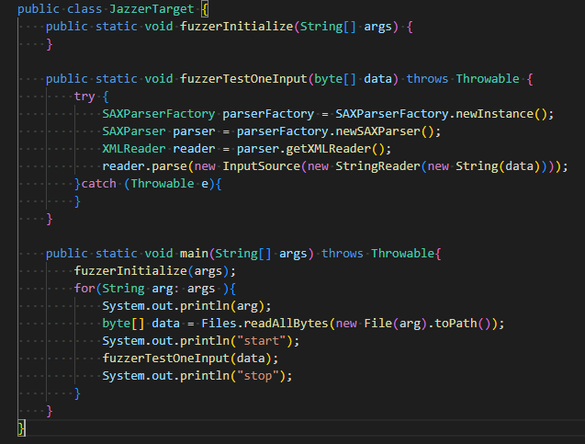
CVE-2022-23437
This is a code from vulnerable library
Can you spot a vulnerability with a code review? Here’s original source code:
Look for: public int scanLiteral(int quote, XMLString content)
And try to find vulnerability with source code review ☺
DEMO TIME!

Slide 29
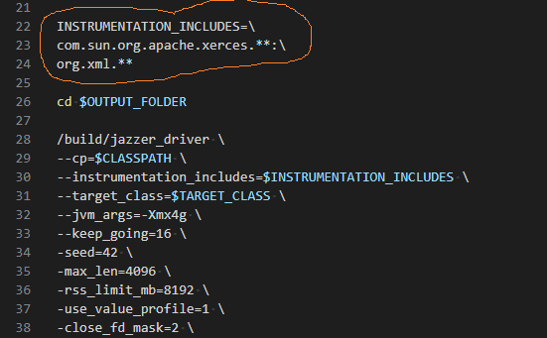
CVE-2022-23437
DEMO TIME!
Let’s run a script!

Slide 30
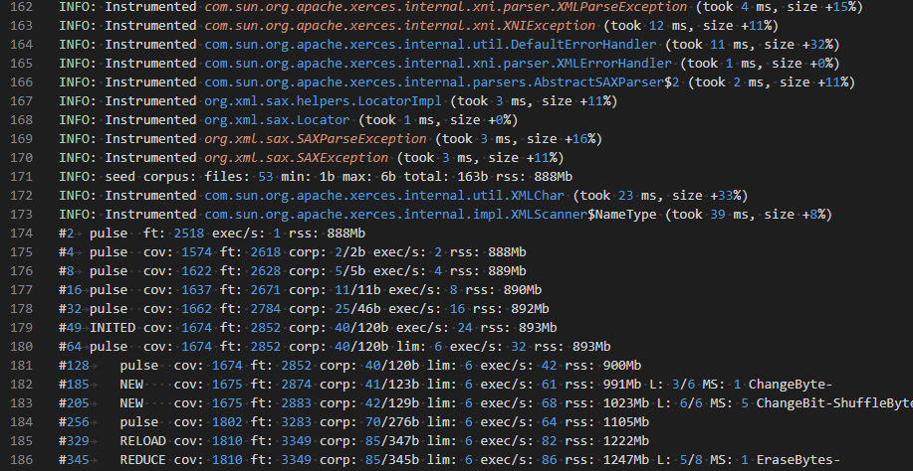
CVE-2022-23437
DEMO TIME!
Around 10 mins…

Slide 31
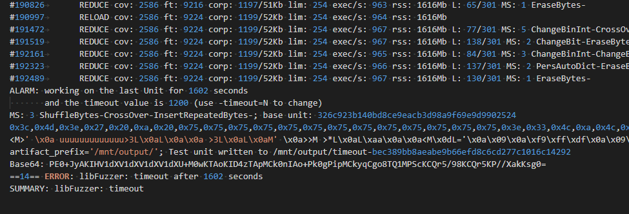
CVE-2022-23437
DEMO TIME!
If the fuzzer gets into a loop for 12 mins – it shuts down . Now we have an infinite loop!

Slide 32
CVE-2022-23437
DEMO TIME!
Here’s a payload that creates an infinite loop

Slide 33
CVE-2022-23437
DEMO TIME!
Please enjoy the demo! Play with the code and fuzzer. Use docker
https://gitlab.com/spacewasp1982/xerces-fuzzer-demo

Slide 34
Conclusion
Fuzzing is one of the most important security practices
Part of SDLC
Java is everywhere!!
Third-party libs is a big problem
Fuzz fuzz fuzz!

Slide 35
Vladimir Dashchenko
Twitter: @VDashchenko v.d.dashchenko@gmail.com
Sergey Temnikov
Temnikov_s@mail.ru

